Slide 1

2025 NEBRASKA VETMOM CONOPS

Slide 2
NEBRASKA UNDERSERVED DENTAL POPULATIONS
#1 RURAL RESIDENTS
#2 YOUNG CHILDREN/ADOLESCENTS
#3 LOW INCOME/UNINSURED
#4 ETHNIC MINORITY PEOPLE
#5 SENIOR OLDER ADULTS
#6 PEOPLE WITH DISABILITIES
#7 MILITARY VETERANS
#8 NEW IMMIGRANTS/REFUGEES
#9 PREGNANT WOMEN
#10 HOMELESS PEOPLE

Slide 3






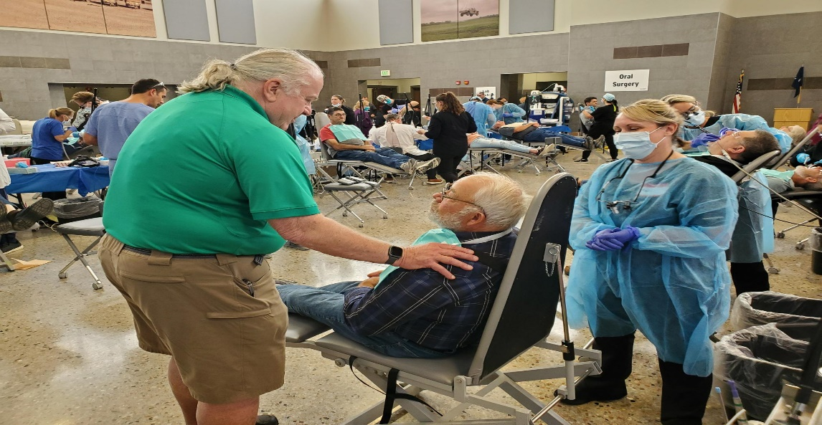
NEBRASKA VETERAN DENTAL CARE NEED
“Approximately 119,645 veterans reside in Nebraska. Around 90% of veterans do not receive dental care through the USDVA. The lack of access to affordable dental care for veterans is the number one requested need of Nebraska Veterans and likely across the United States”
Levi E. Bennett
Deputy Director
Nebraska Department of Veterans’ Affairs
This Photo by Unknown Author is licensed under CC BY-SA
This Photo by Unknown Author is licensed under CC BY-SA
This Photo by Unknown Author is licensed under CC BY-SA
This Photo by Unknown Author is licensed under CC BY-SA
This Photo by Unknown Author is licensed under CC BY

Slide 4

3RD NEBRASKA VETERANS MISSION OF MERCY EVENT
NATIONAL ARMY GUARD TITAN READINESS CENTER
CAMP MEAD YUTAN NEBRASKA
DATES 25-27 SEPTEMBER 2025
This Photo by Unknown Author is licensed under CC BY-SA
This Photo by Unknown Author is licensed under CC BY-SA
This Photo by Unknown Author is licensed under CC BY-SA
This Photo by Unknown Author is licensed under CC BY-SA
This Photo by Unknown Author is licensed under CC BY

Slide 5


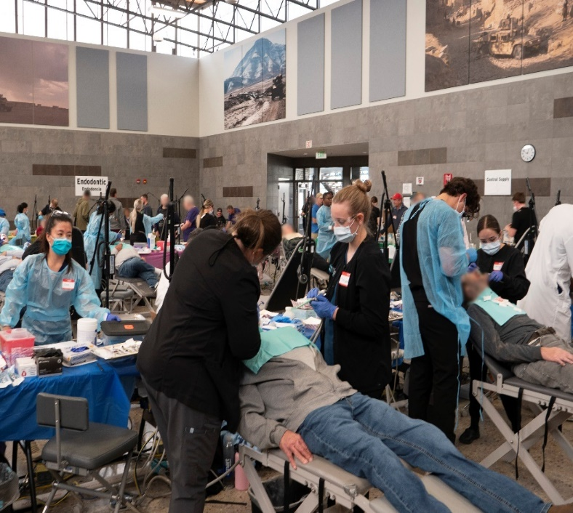
VETMOM PARTNERS
A Joint Multi-Agency Collaboration
NEBRASKA DENTAL FOUNDATION
DHHS OFFICE OF ORAL HEALTH
NEBRASKA NATIONAL GUARD
NEBRASKA DEPT OF VETERANS’ AFFAIRS
COUNTY VETERAN SERVICE OFFICERS
NEBRASKA DENTAL ASSOCAITION
NEBRASKA DENTAL HYGIENE ASSOCAITION
UNMC COLLEGE OF DENTISTRY
CREIGHTON UNI SCHOOL OF DENTISTRY
AMERICA DENTIST CARE FOUNDATION
DENTAL DESIGNS LABORATORY
DEXIS IMAGING SOLUTIONS
PATTERSON DENTAL SUPPLY
This Photo by Unknown Author is licensed under CC BY-SA
This Photo by Unknown Author is licensed under CC BY-SA
This Photo by Unknown Author is licensed under CC BY-SA
This Photo by Unknown Author is licensed under CC BY-SA
This Photo by Unknown Author is licensed under CC BY

Slide 6
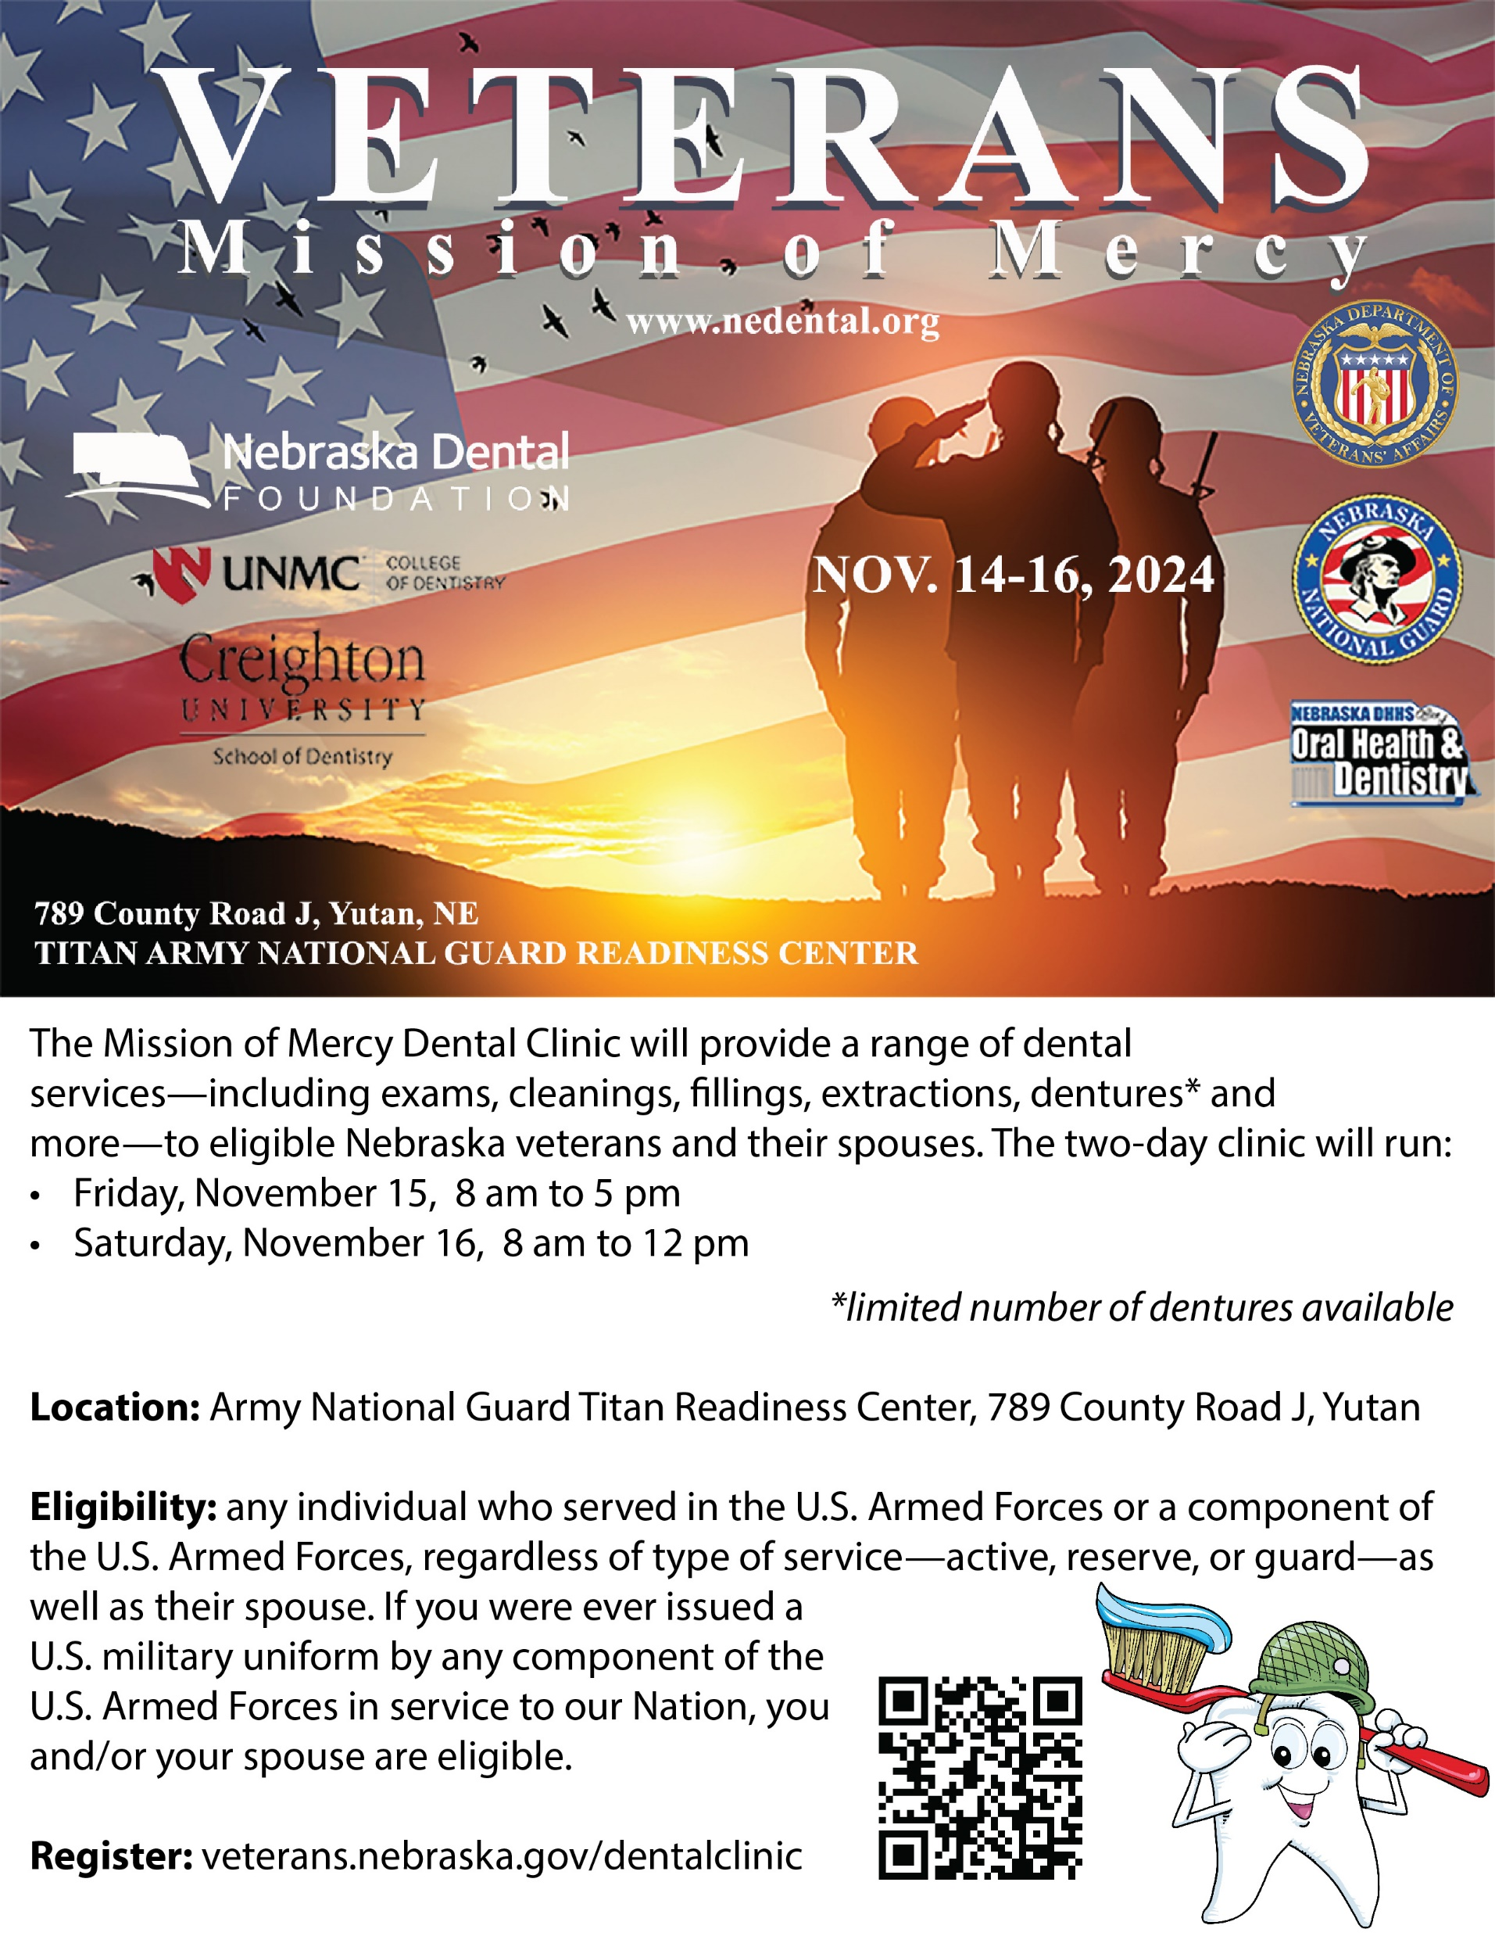
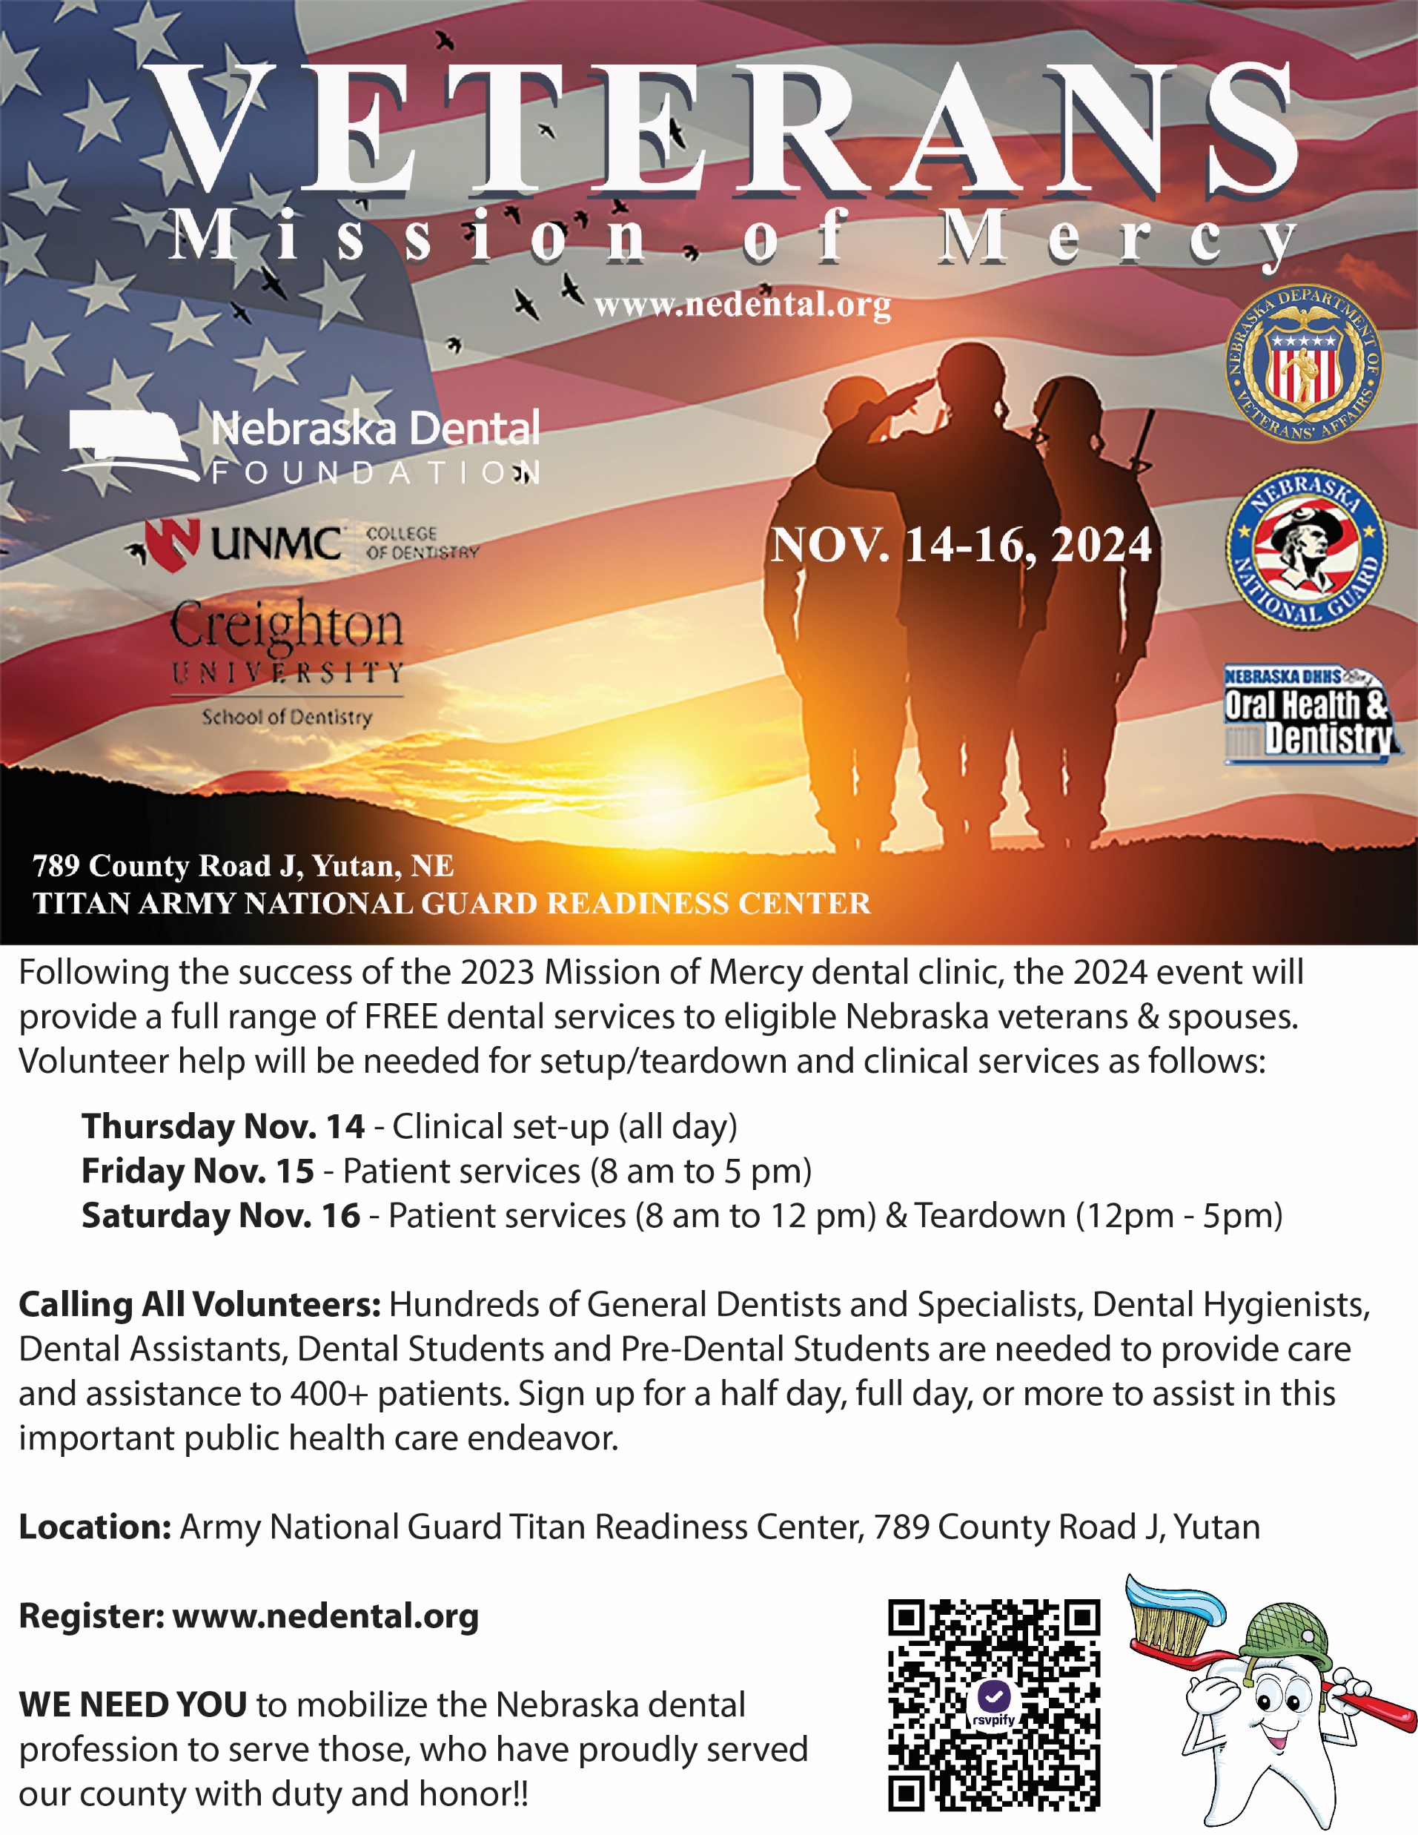
VETERAN/SPOUSE PATIENT AND DENTAL VOLUNTEER SIGN UPS

Slide 7
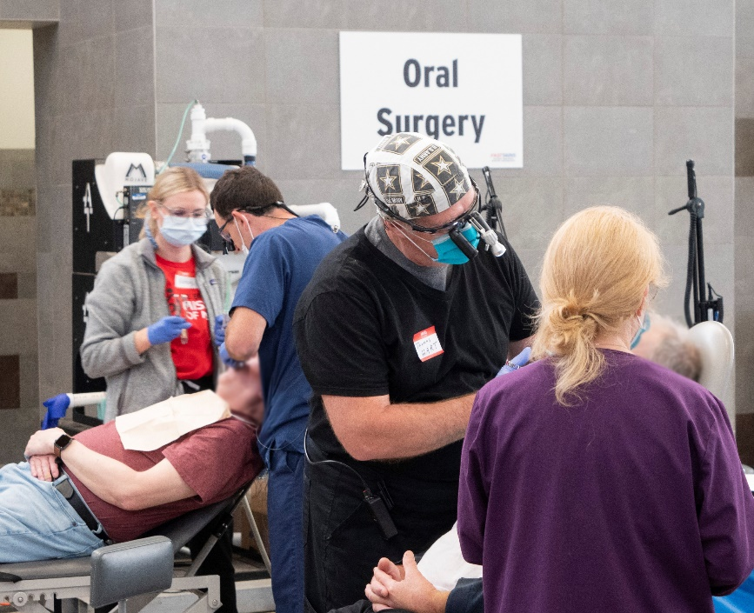
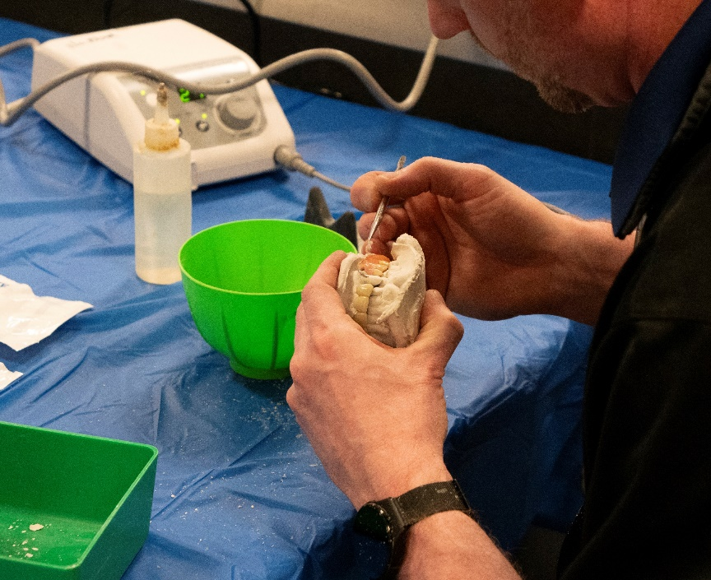
2024 VETMOM ACHIEVEMENTS
400+ DENTAL VOLUNTEERS
473 VETERAN SPOUSE ENCOUNTERS
2714 DENTAL SERVICES PROVIDED
156 DENTURE ARCHES PROVIDED
67 AVERAGE VETERAN AGE
56% RURAL RESIDENTS
99% WOULD ATTEND FUTURE EVENT
$653,487 TOTAL CARE VALUE
2023-2024 COMBINED:
OVER 650 VOLS
OVER 700 PATIENT ENCOUNTERS
OVER 1 MILLION USD
This Photo by Unknown Author is licensed under CC BY-SA
This Photo by Unknown Author is licensed under CC BY-SA
This Photo by Unknown Author is licensed under CC BY-SA
This Photo by Unknown Author is licensed under CC BY-SA
This Photo by Unknown Author is licensed under CC BY

Slide 8

2024 VETMOM EXPENSES
Estimated
ADCF EQUIPMENT 40,000
DENTAL SUPPLIES 15,000+
ELECT/PLUMB COSTS 5,000+
FOOD AND DRINKS 3,500
EVENT PROMOTION 2000+
COMPUTER SOFTWEAR 1500
VETERAN DISPLAY 500
APPROX TOTAL: $65,000+
This Photo by Unknown Author is licensed under CC BY-SA
This Photo by Unknown Author is licensed under CC BY-SA
This Photo by Unknown Author is licensed under CC BY-SA
This Photo by Unknown Author is licensed under CC BY-SA
This Photo by Unknown Author is licensed under CC BY

Slide 9
2024 VETMOM DONORS
H HORNADY MANUFACTURING
GOOGLE NEBRASKA
AMERITAS
DELTA DENTAL
BLUE CROSS
DEXUS IMAGING
PATTERSON DENTAL
DENTAL DESIGNS LAB
LDDA GOLF EVENT JUNE
RAW NERVE CONCERT SEPT
This Photo by Unknown Author is licensed under CC BY-SA
This Photo by Unknown Author is licensed under CC BY-SA
This Photo by Unknown Author is licensed under CC BY-SA
This Photo by Unknown Author is licensed under CC BY-SA
This Photo by Unknown Author is licensed under CC BY

Slide 10
Golf June 24
Concert Sept 24

Slide 11
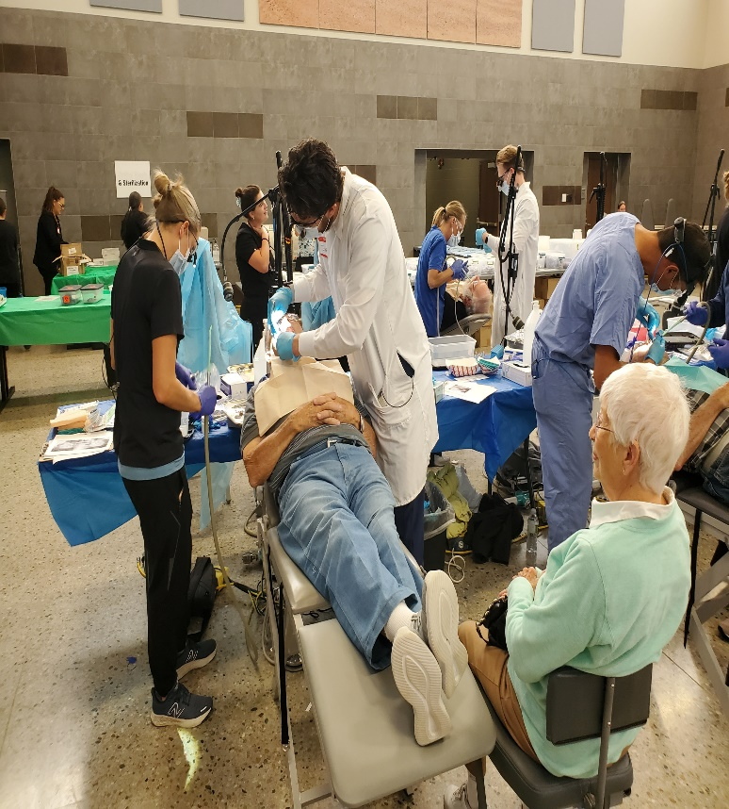
This Photo by Unknown Author is licensed under CC BY-SA
This Photo by Unknown Author is licensed under CC BY-SA
This Photo by Unknown Author is licensed under CC BY-SA
This Photo by Unknown Author is licensed under CC BY-SA
This Photo by Unknown Author is licensed under CC BY

Slide 12
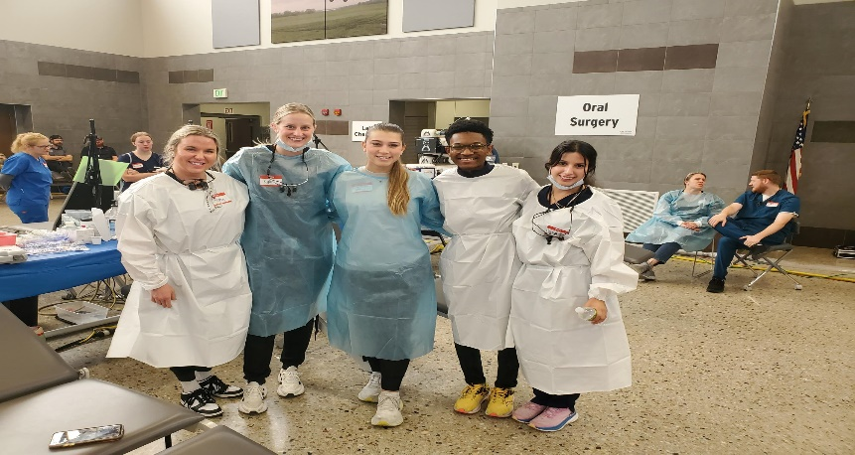
IT IS A PROFESSIONAL HONOR TO SERVE THOSE
WHO HAVE SERVED OUR COUNTRY!!!
This Photo by Unknown Author is licensed under CC BY-SA
This Photo by Unknown Author is licensed under CC BY-SA
This Photo by Unknown Author is licensed under CC BY-SA
This Photo by Unknown Author is licensed under CC BY-SA
This Photo by Unknown Author is licensed under CC BY

Slide 13
NEBRASKA VETMOM 2025 CONTACTS:
-David O’Doherty JD david@allophone.com
Director Nebraska Dental Foundation #402-440-7693
-Levi Bennett levi.bennett@nebraska.gov
Deputy Director NDVA #531-739-8032
-Dr. Charles F. Craft charles.craft@nebraska.gov
NE State Dental Health Director #402-432-4482-
-Dr. Jim Jenkins jfjenkins@unmc.edu
UNMC College of Dentistry #402-525-5521
-Dr. Steve Anderson stevefa@kdsi.net
Grand Island #308-380-6544
This Photo by Unknown Author is licensed under CC BY-SA
This Photo by Unknown Author is licensed under CC BY-SA
This Photo by Unknown Author is licensed under CC BY-SA
This Photo by Unknown Author is licensed under CC BY-SA
This Photo by Unknown Author is licensed under CC BY

