Slide 1
ADA Pilot Project
May 14, 2024
Matt Zaborowski, MPH, CPH
Sr. Manager, Medicaid Programs & Health Policy

Slide 2
Council on Advocacy for Access and Prevention (CAAP)
Guiding the Community and the Profession
Historic passage of a health equity resolution (2021)
Establishment of a Medicaid Reform Task Force
  Passed a more comprehensive Dental Medicaid Policy (2023)
  Established a road map for reforms including federal, state, dental schools, dentist education, etc.
  Recreated the Medicaid Advisory Committee (MAC) who recommends policy, education programs, and champions state reforms

Slide 3
ADA – Medicaid Pilot Project
Improve provider participation in Medicaid
Increase utilization of dental services for children and adults

Slide 4
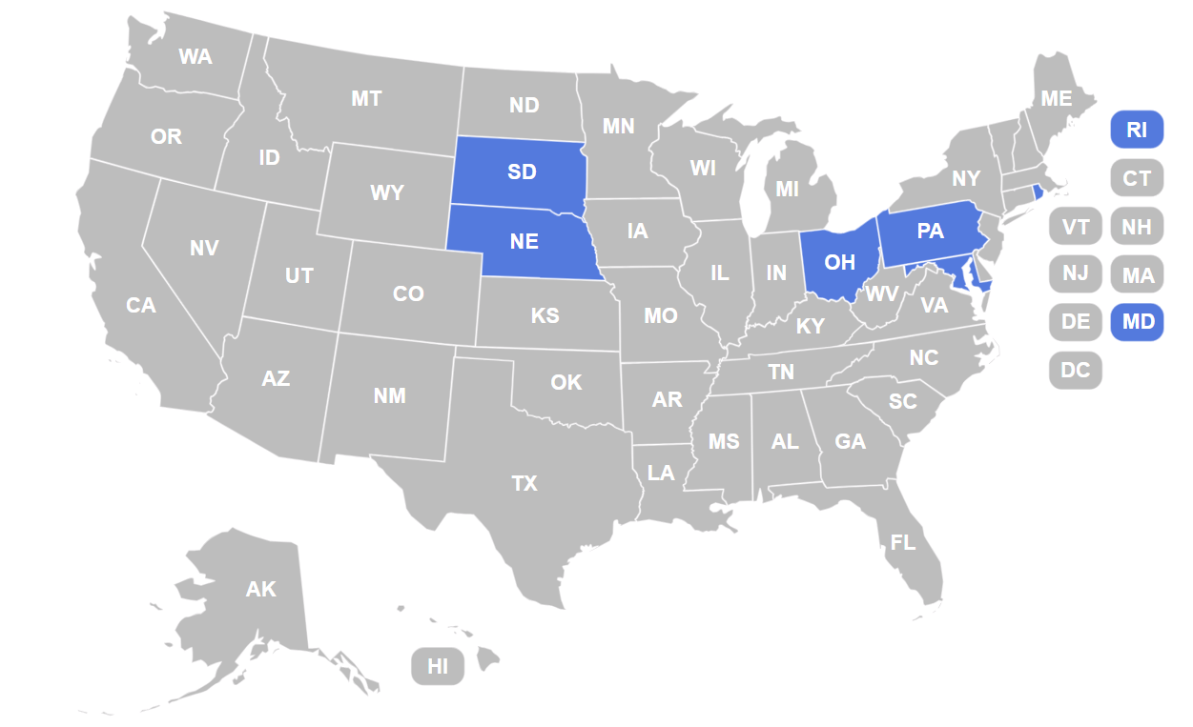
List of Pilot States
Nebraska
South Dakota
Ohio
Pennsylvania
Rhode Island
Maryland

Slide 5
Strategy
Phase 1:
Establish State Teams
Phase 2:
Identify State-specific Goals & Strategies
Phase 3:
Convene a Collaborative & Share Outcomes

Slide 6
Goals
Increase the number of Medicaid providers with claims for Medicaid beneficiaries by 5–10%.
Increase the number of Medicaid providers with claims for more than 100 Medicaid beneficiaries by 5–10%.
Measure change in the number of Medicaid beneficiaries receiving dental services by category of service.

Slide 7
Approach
Leadership Champions
Engage in state-based teams to establish strategic goals.
Participate in a Collaborative (quarterly) with CMS.
Establish Medicaid data / surveillance analysis to achieve goals and monitor trends.
Engage in evaluation practices (state-based & within the Collaborative).
Evaluation (Data)
Collaboration
Promote continued partnership and a shared vision to improve oral health outcomes amongst Medicaid beneficiaries.

Slide 8
Overarching State Pilot Strategy
Engagement
Ensure active state level dental technical advisory committee.
Determine initiatives and activities to improve provider participation in Medicaid to increase utilization of dental services for children and adults.
State-Driven Systems

Slide 9
Expected Outcomes & Affiliated Actions
Improve Provider Participation & Patient Utilization
Address Barriers to Care
Increase Community Dental Health Coordinators (CDHC)
Data sharing for children and adults
Conduct dentist surveys on reasons for participation or non-participation in Medicaid
Support with legislative initiatives such as dental loan repayment based on Medicaid engagement
Best practices on age 1 dental home and ED deferrals for non-traumatic dental visits

Slide 10

Questions?
Email me at zaborowskim@ada.org

