Slide 1
State of the U.S. Dental Care Market
Thank you for joining! You will be on hold until the call begins at 12 p.m. Central time
Please remember to mute your phone unless you are speaking.
This webinar will be recorded.
Streaming audio is available through your computer. If you’d like to call in to listen to the audio via phone, dial 888-203-5515, and then enter conference ID 5652737.

Slide 2
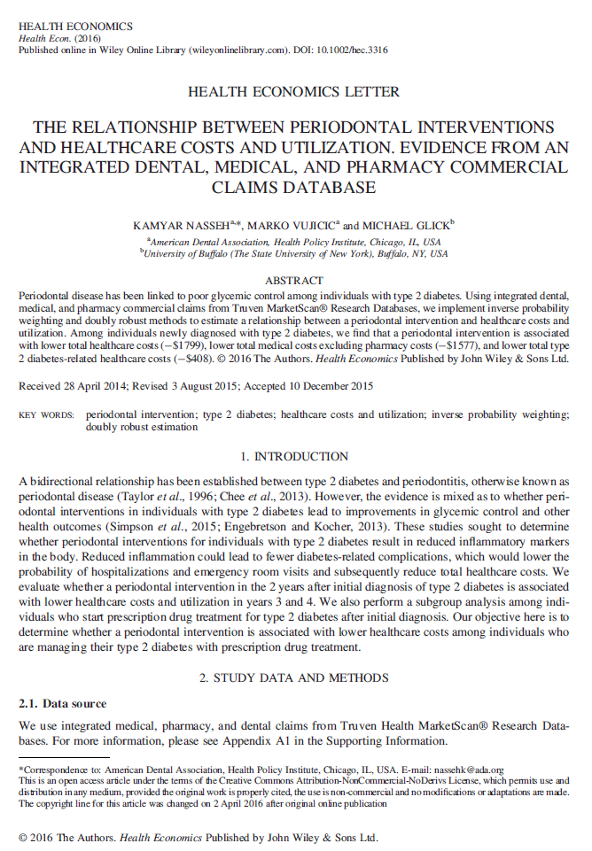
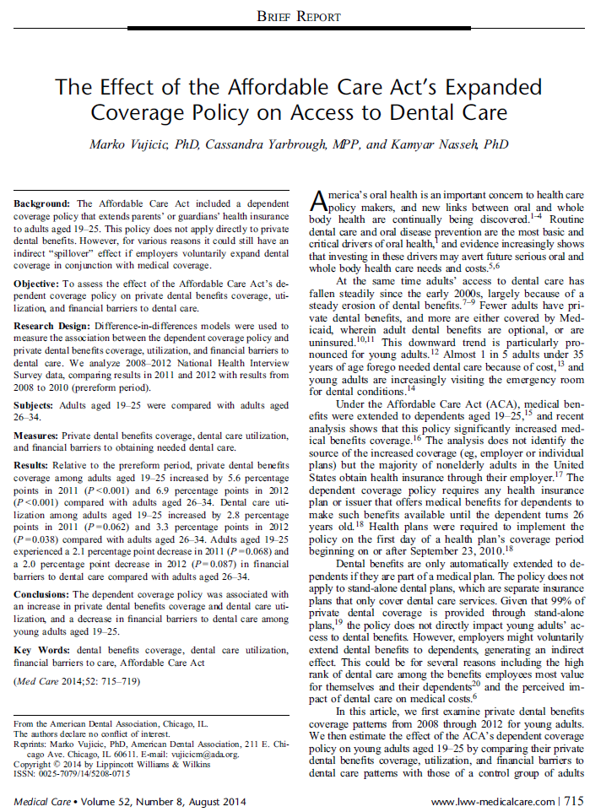
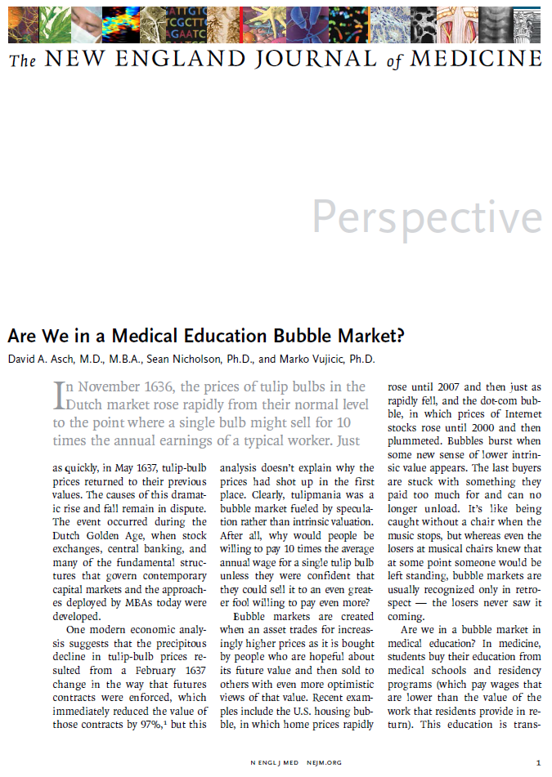
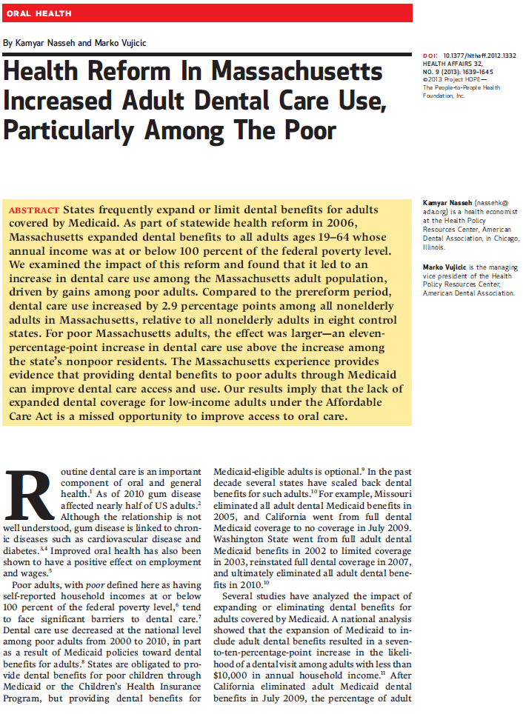
The ADA Health Policy Institute

Slide 3
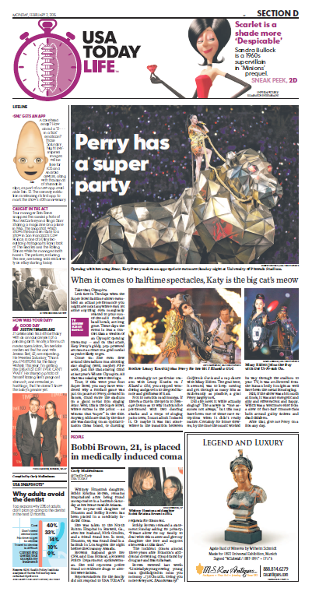
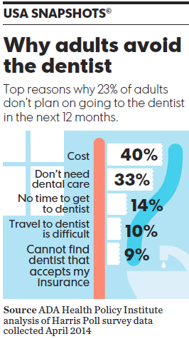

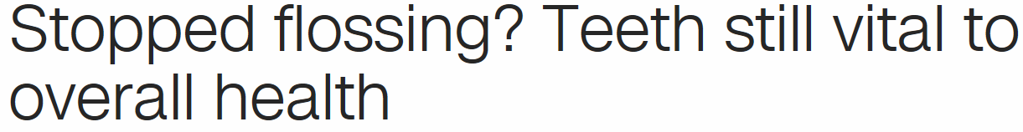

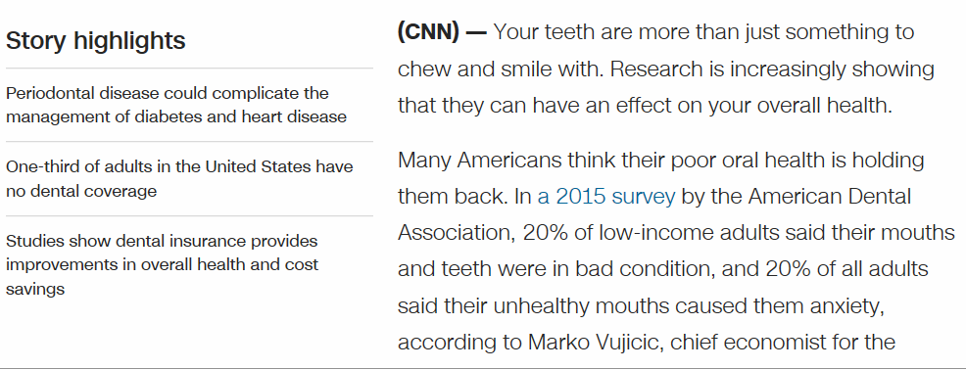
The ADA Health Policy Institute

Slide 4
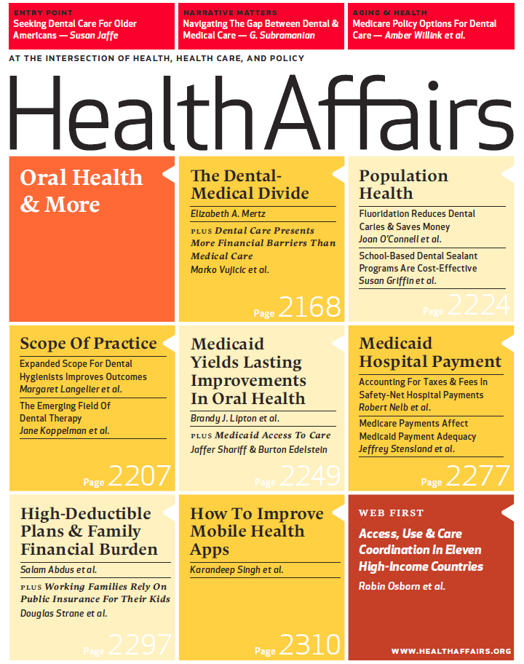
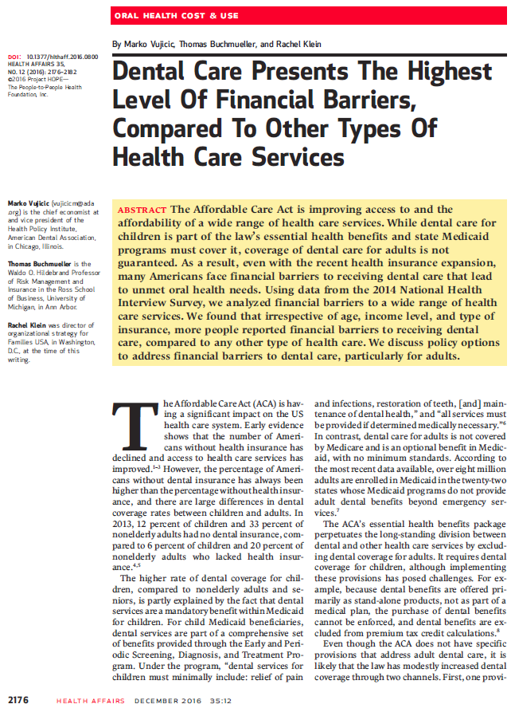
The ADA Health Policy Institute

Slide 5
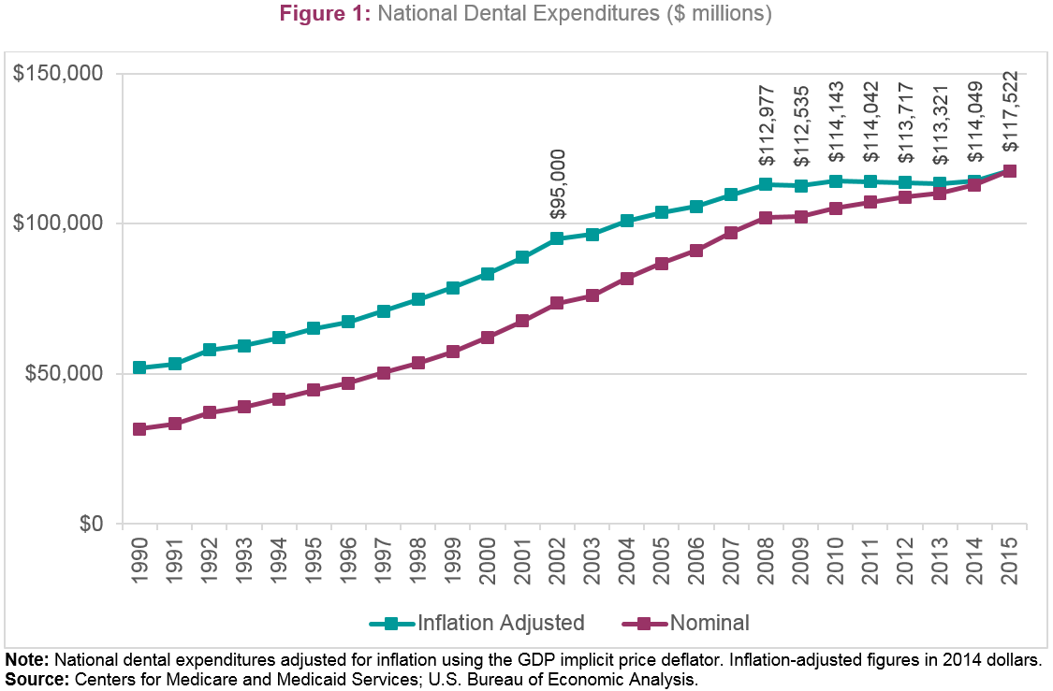
The Dental Economy

Slide 6
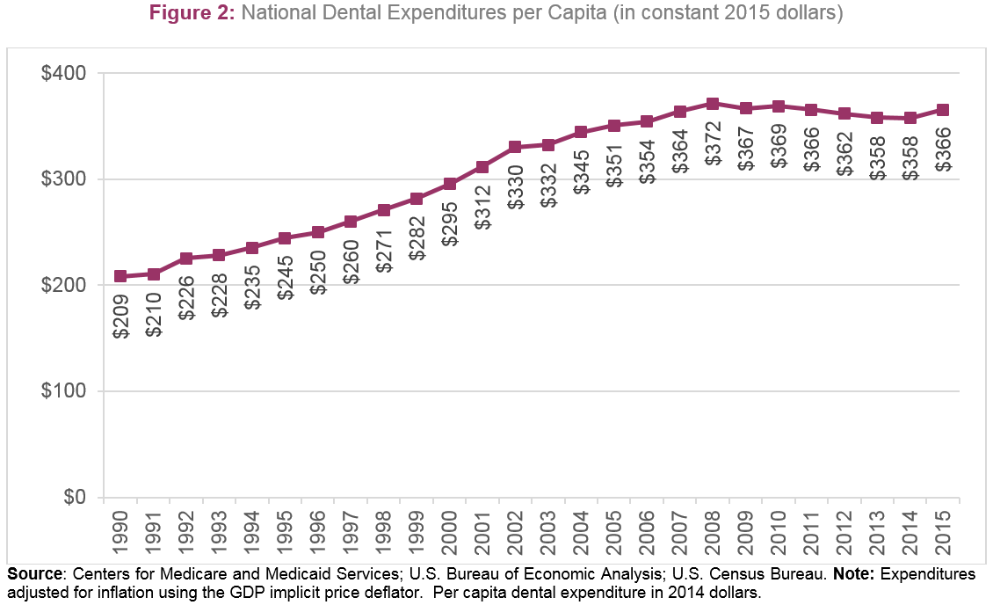
The Dental Economy

Slide 7
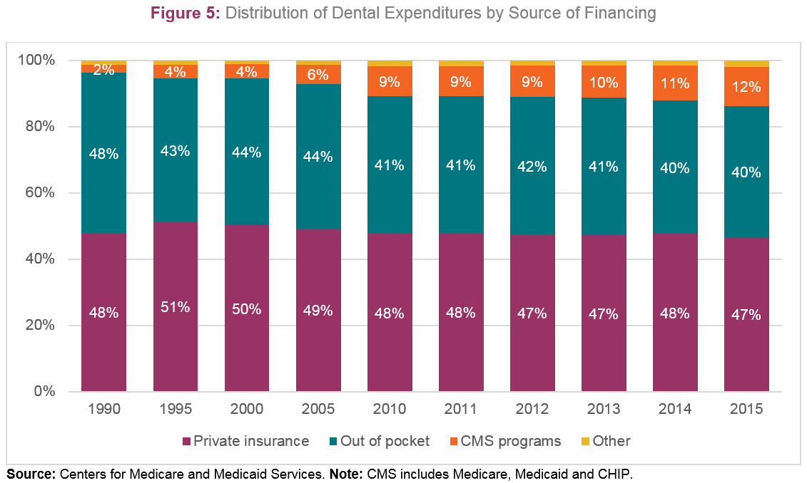
The Dental Economy

Slide 8
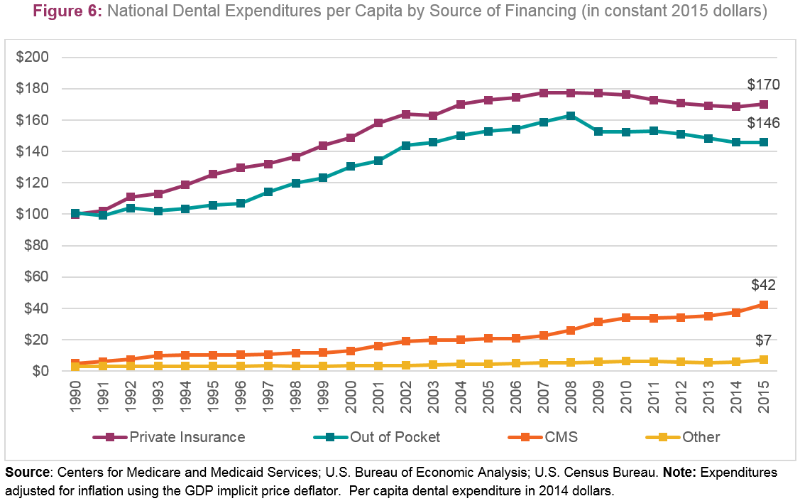
The Dental Economy

Slide 9
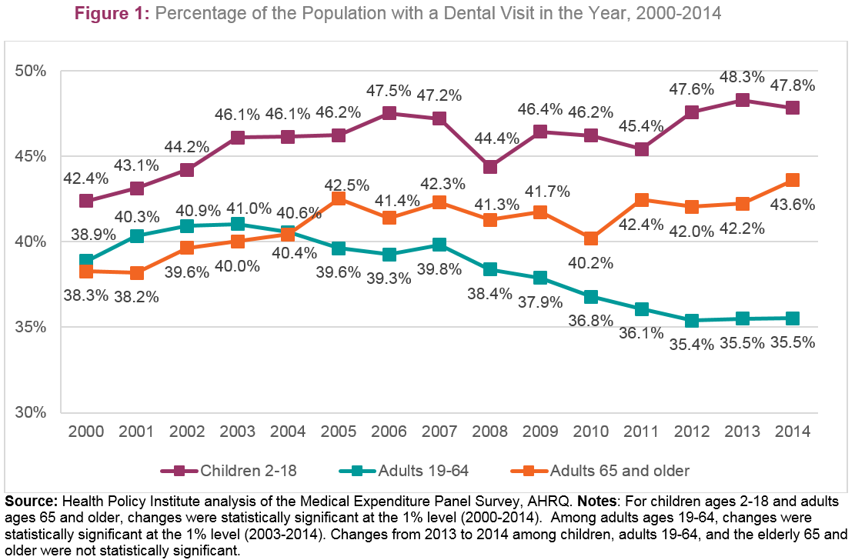
Dental Care Utilization

Slide 10
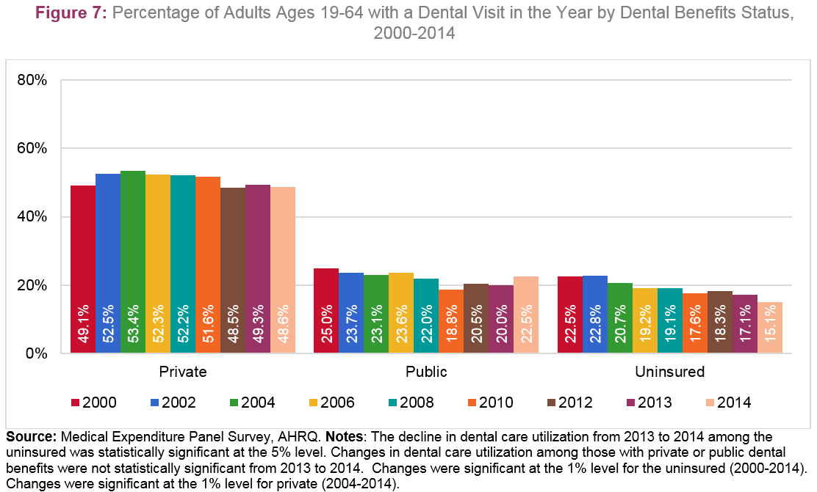
Dental Care Utilization

Slide 11
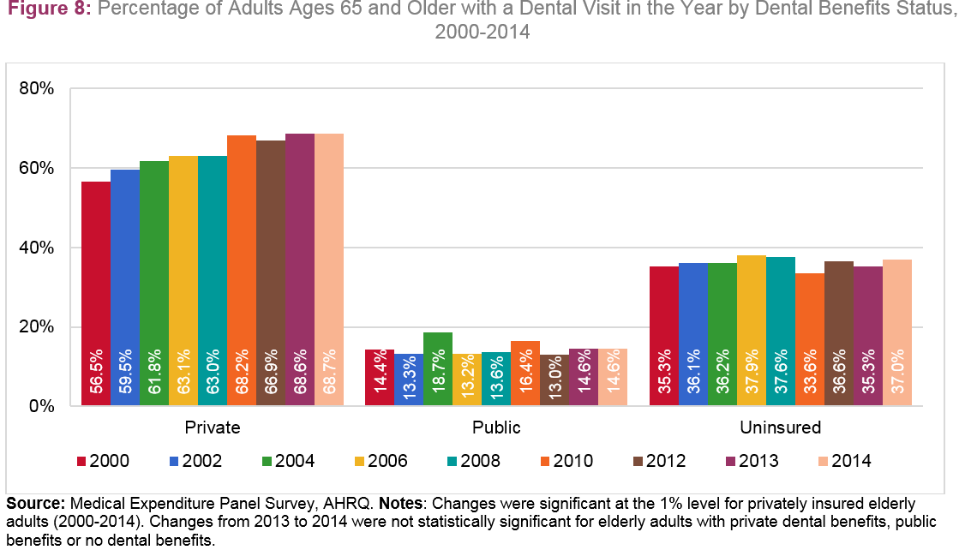
Dental Care Utilization

Slide 12
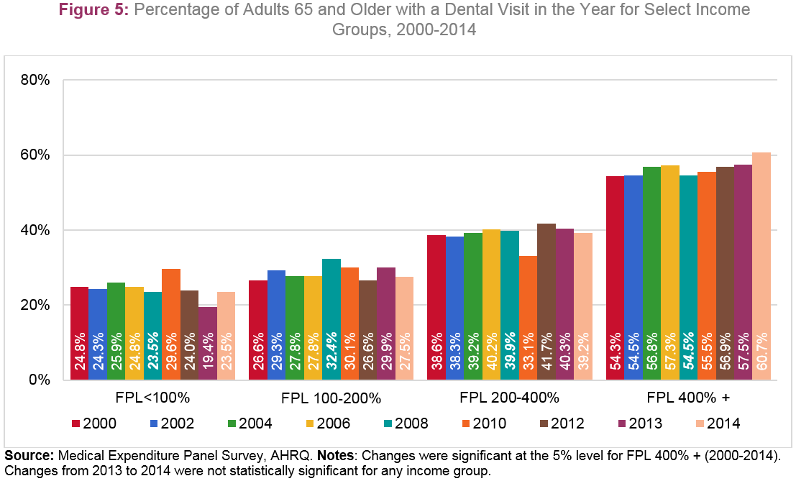
Dental Care Utilization

Slide 13
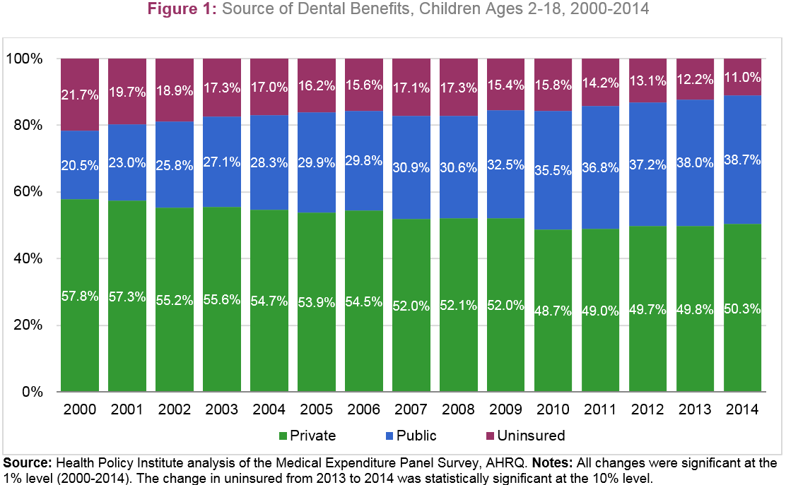
Dental Benefits Coverage

Slide 14
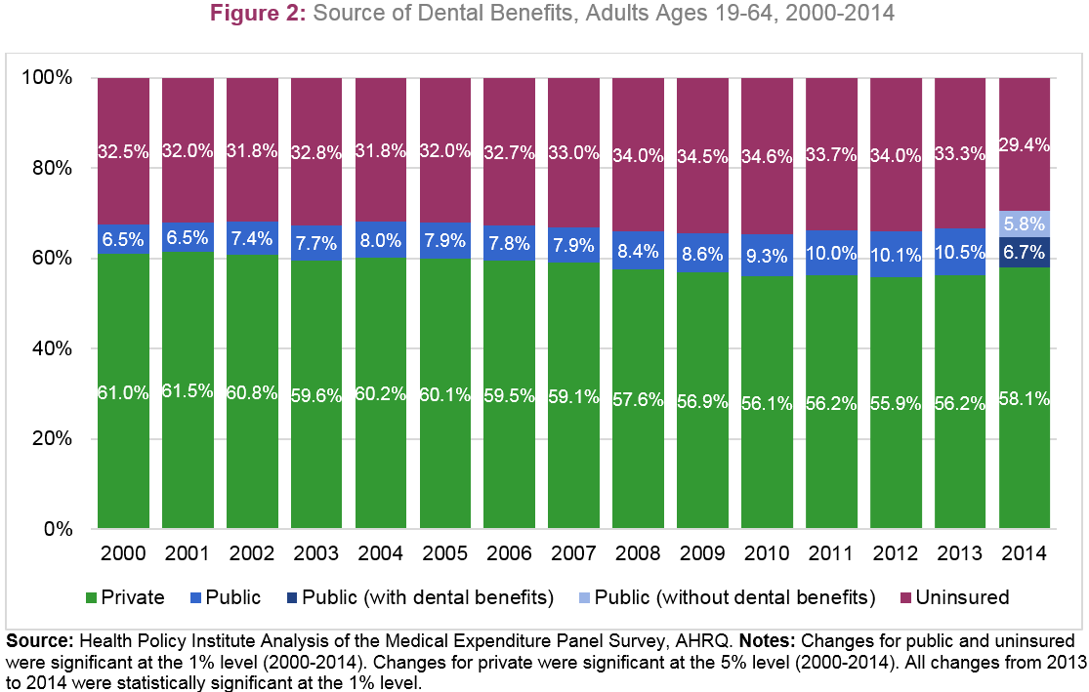
Dental Benefits Coverage

Slide 15
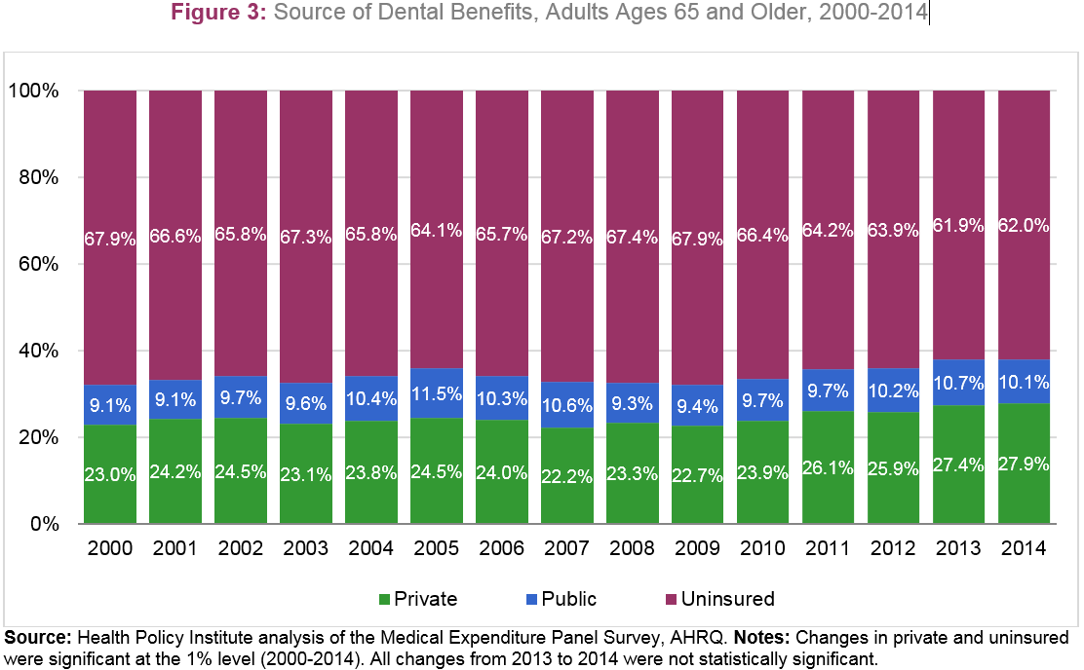
Dental Benefits Coverage

Slide 16
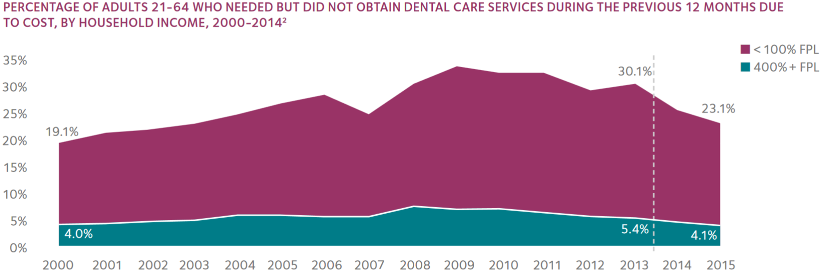

Barriers to Dental Care

Slide 17
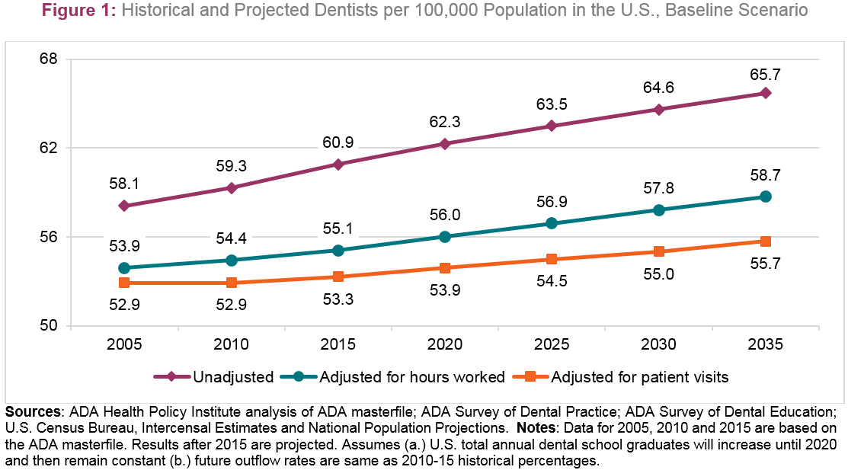
Supply of Dentists

Slide 18
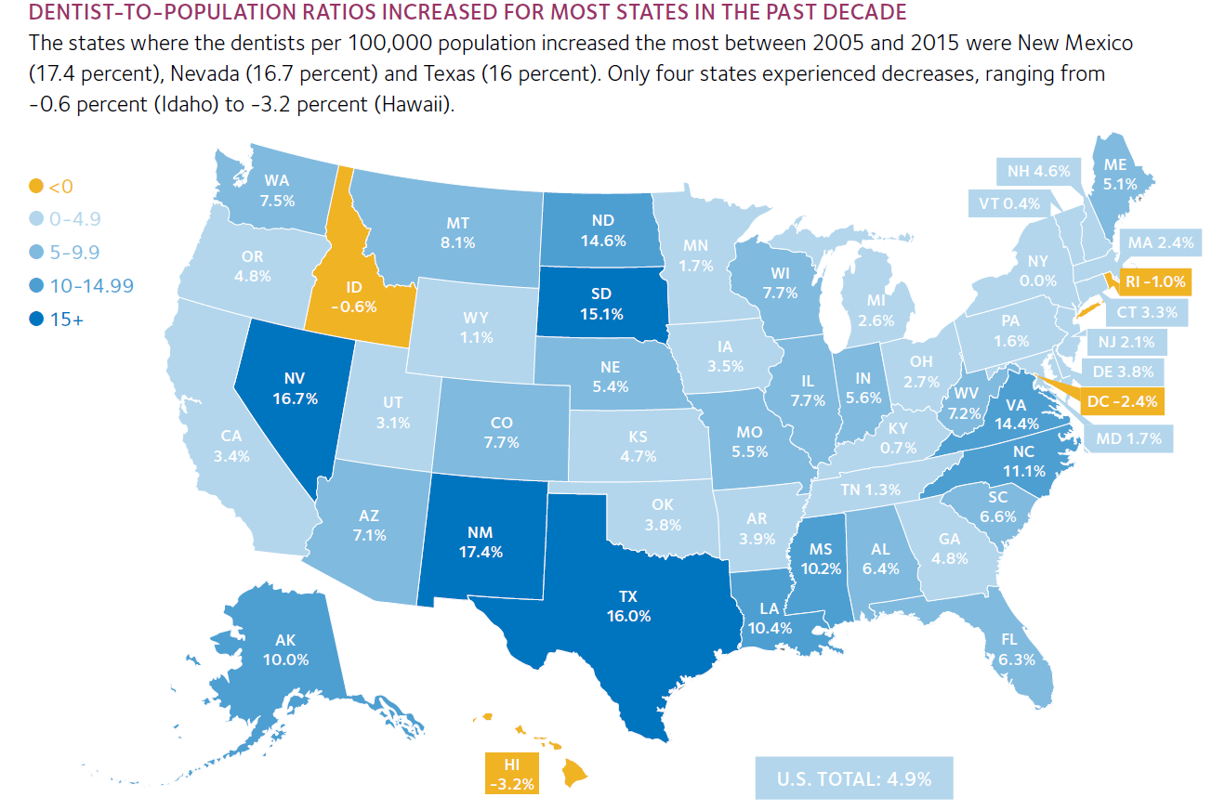
Supply of Dentists

Slide 19
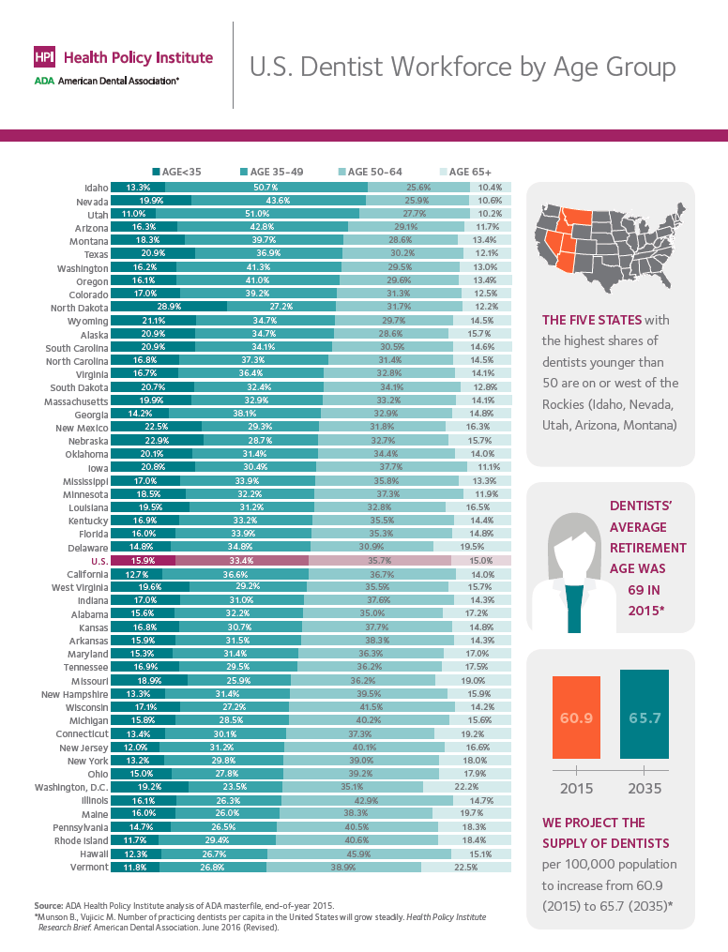
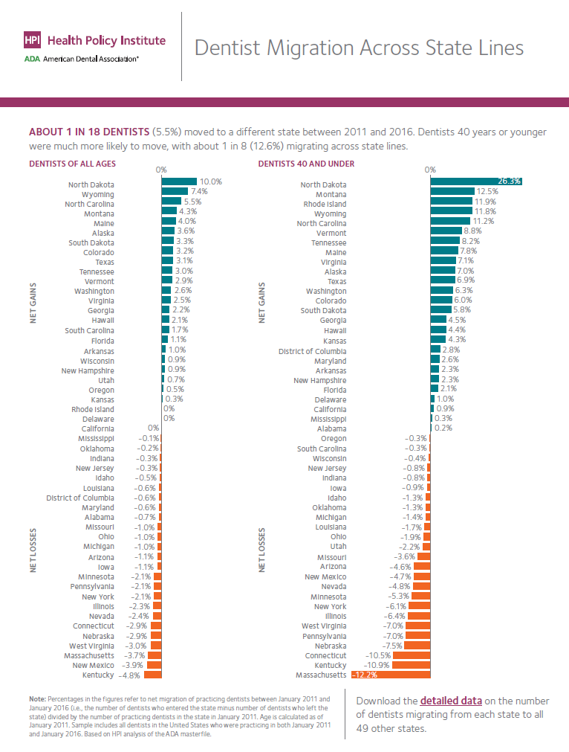
Supply of Dentists

Slide 20
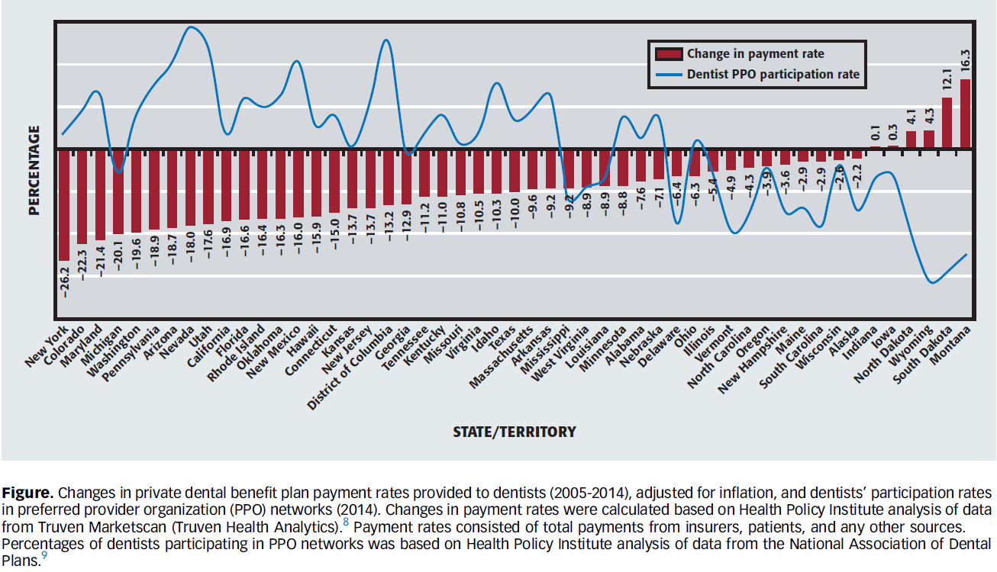
Reimbursement

Slide 21
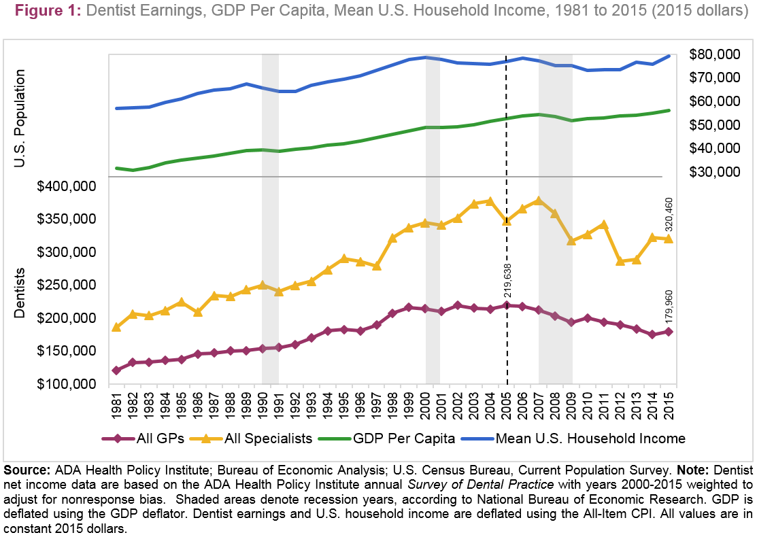
Dentist Earnings & Busyness

Slide 22
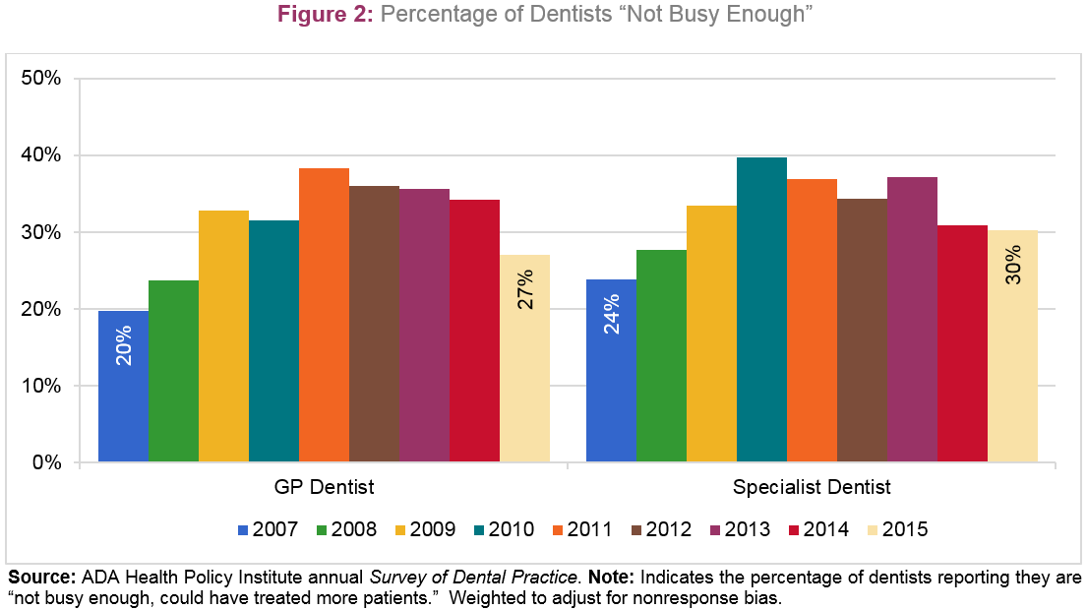
Dentist Earnings & Busyness

Slide 23
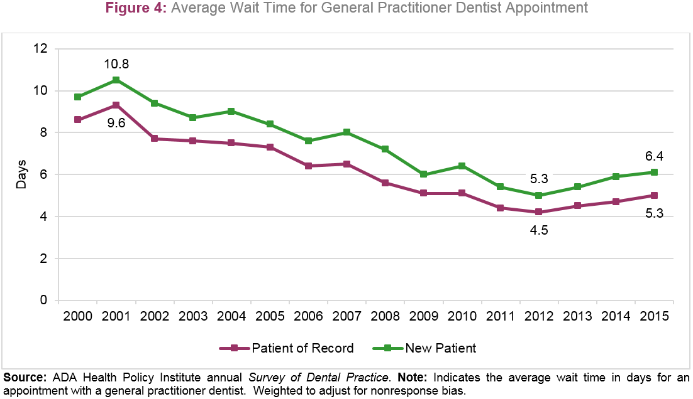
Dentist Earnings & Busyness

Slide 24
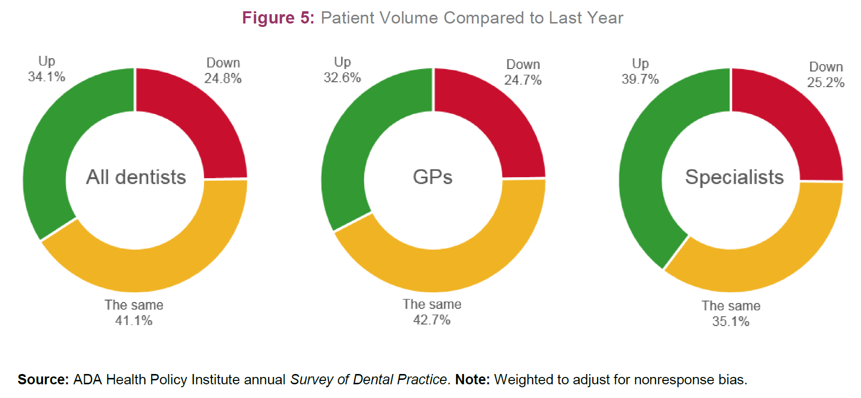
Dentist Earnings & Busyness

Slide 25

Looking Forward
Supply and Demand
Medicaid
The Value Agenda
Broader Health Reform

Slide 26


Thank You!
Learn more about other
ADA Health Policy Institute work:
ADA.org/HPI
To inquire about speaking engagements or custom data analytics, please contact:
hpi@ada.org

